Slide 1



Mutual Fund
A mutual fund is a professionally managed investment scheme, usually run by an Asset Management Company (AMC), that pools money from many investors to purchase securities.
Professional Management
Diversification
Investor Pooling
Investment Growth
Securities
Prospectus

Slide 2

Equity Funds: Primarily invest in stocks.
Large Cap Funds: Invest in companies with large market capitalization.
Mid Cap Funds: Invest in companies with medium market capitalization.
Small Cap Funds: Invest in companies with small market capitalization.
Multi Cap Funds: Invest across companies of all market capitalizations.
Sectoral Funds: Invest in specific sectors like technology, healthcare.
Thematic Funds: Invest based on a specific theme, such as infrastructure.
Types of Mutual Funds
Risk Tolerance
Hedge against inflation, market volatility
Potential for higher returns, higher risk
Balances risk and return
Offers stable returns, lower risk
Provides high liquidity, very low risk
Gold Funds
Debt Funds: Primarily invest in fixed-income securities like bonds, government
Liquid Funds ,Short Duration Funds, Long Duration Funds, Corporate Bond Funds, Gilt Funds
Equity Funds
Hybrid Funds
Hybrid Funds: Invest in a combination of equity and debt instruments
Aggressive Hybrid Funds, Conservative Hybrid Funds, Balanced Hybrid Funds
Debt Funds
Money Market Funds: Invest in very short-term, low-risk debt instruments.
Gold Funds: Invest in gold or gold-related instruments. hedge against inflation.
Money Market Funds

Slide 3
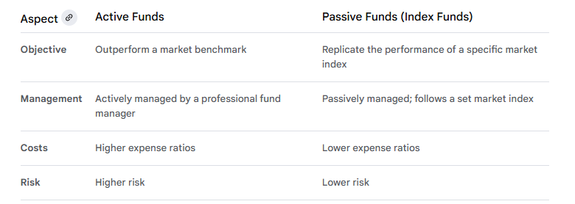
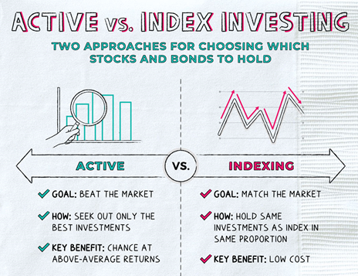

Slide 4
Mutual Fund Direct vs. Regular Schemes
Direct schemes are mutual fund plans where investors invest directly with the Asset Management Company (AMC), bypassing any intermediaries like distributors or brokers.
Key Characteristics of Direct Schemes:
Lower Expense Ratio
Direct Interaction with AMC
Online Direct Platforms Access.
Direct Schemes
Lower costs, suitable for informed investors
Regular Schemes
Higher costs, suitable for beginners
Regular schemes are mutual fund plans where investments are made through intermediaries such as distributors, brokers, or financial advisors.
Key Characteristics of Regular Schemes:
Higher Expense Ratio
Intermediary Assistance
Suitable for without experience Investors

Slide 5
Direct Mutual Funds
Pros
Cons
Lower fees
Lower expense ratio leads to higher long- term returns for
investors.
1
1
No advice
No advisory services require investors to make independent decisions.
Direct interaction
Direct interaction with AMC for all transactions enhances control.
2
2
Informed investors
Suitable only for investors with strong market knowledge and risk tolerance.
Online access
Convenient access through AMC's website or online platforms.
3
3
Self-research
Investors must conduct their own research without external advice.

Slide 6


Regular Mutual Funds
Pros
Cons
Intermediary Assistance
Higher Expense Ratio
Novice-Friendly
Commission-Driven Advice
Wider Accessibility
Advisory Services

Slide 7
Expense Ratio: The Key Differentiator
Let's assume you invest ₹1,00,000 in a mutual fund scheme that generates an average annual return of 12%.
Direct Scheme: Expense ratio of 0.5 to max 1.0%
Regular Scheme: Expense ratio of 1.5 to 2.5 %
After 20 years, the difference in returns can be substantial. The direct scheme would likely yield a significantly higher return due to the lower expense ratio.
Expense Ratio Impact on Returns
1
2
3
Direct Schemes
Lower expense ratios lead to higher long-term returns.
Regular Schemes
Higher expense ratios reduce long- term returns.
Compounding
Compounding amplifies the impact of expense ratios over time.

Slide 8
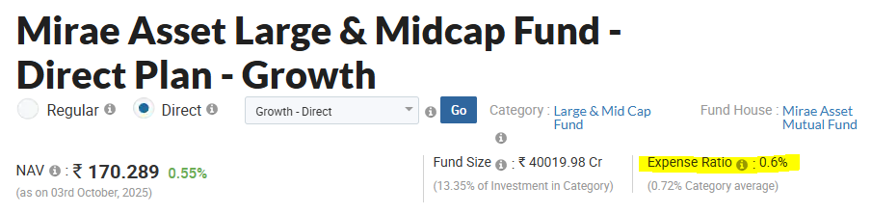

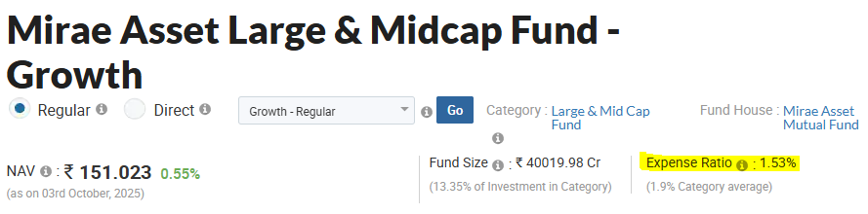
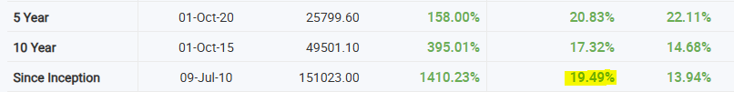

Slide 9
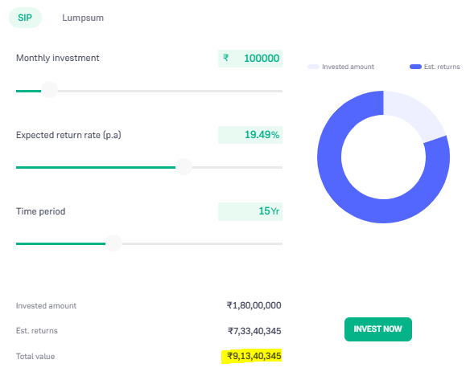
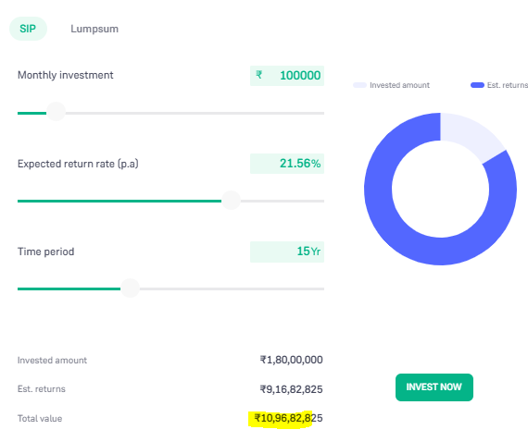
Regular Growth SIP CAGR Return
Direct Growth SIP CAGR Higher Return 1,83,42,480
Compound Annual Growth Rate (CAGR)

Slide 10
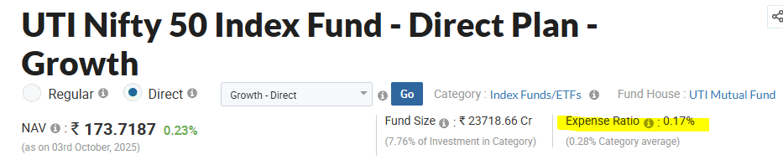
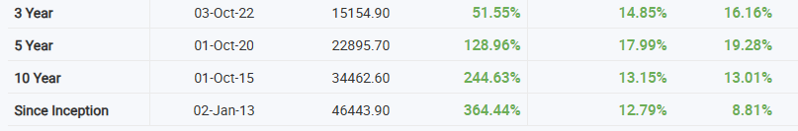
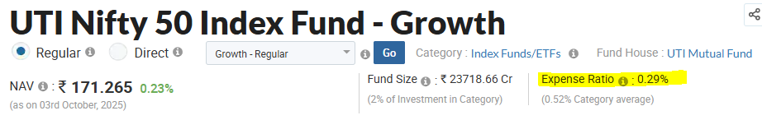
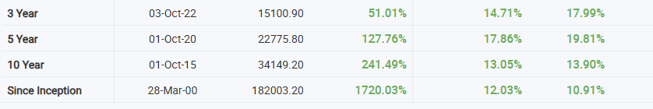

Slide 11








SEBI Approved Website
Mutual funds registrar and transfer agency (RTA) services and managing investor services and transactions.
https://mfs.kfintech.com/investor/
https://newmycams.camsonline.com/user-validation
https://app.mfcentral.com/investor/signin
SEBI Approved App ( Android & iOS)
KYC Validation
https://validate.cvlindia.com/CVLKRAVerification_V1/
https://www.karvykra.com/UPanSearchGlobalWithPanExempt.aspx

Slide 12


KYC Documents
Documents Required Open MF Account for KYC
Proof of Identity (POI): PAN card, Aadhaar card, Passport, Voter ID, Driving License.
Proof of Address (POA): Aadhaar card, Passport, Voter ID, Driving License, Utility Bill (not older than 3 months), Bank Statement (not older than 3 months).
Proof of Identity
Documents like PAN card, Aadhaar card, Passport, Voter ID, Driving License are accepted.
Proof of Address
Documents like Aadhaar card, Passport, Voter ID, Driving License, Utility Bill, Bank Statement are accepted.
Photograph
A recent passport- sized photograph is required for verification.
1
2
3

